Slide 1

Note: The data and information in this document is reflective of a hypothetical situation and client. This document is to be used for KPMG Virtual Internship purposes only.
Sprocket Central Pty Ltd
Data analytics approach
[Division Name] - [Engagement Manager], [Senior Consultant], [Junior Consultant]

Slide 2
Note: The data and information in this document is reflective of a hypothetical situation and client. This document is to be used for KPMG Virtual Internship purposes only.
Agenda
Data Exploration
Model Development

Slide 3
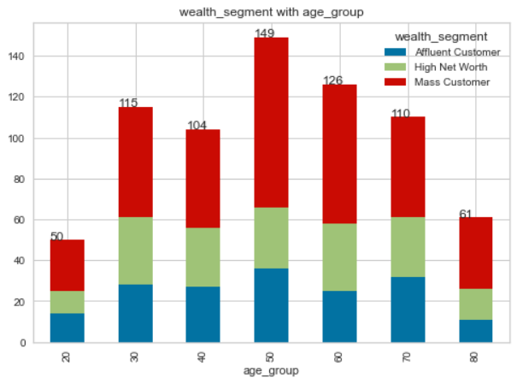
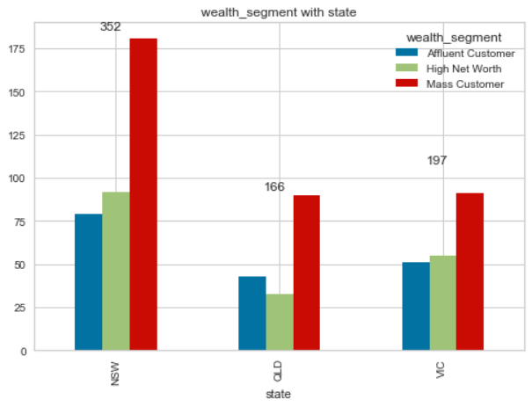
Note: The data and information in this document is reflective of a hypothetical situation and client. This document is to be used for KPMG Virtual Internship purposes only.
Data Exploration
Wealth segment
Data show that a lot of high profile customer in age group of 40 – 60
Most of new customer is in 50 – 60 age group
NSW has the largest population and high amount of high profile customer

Slide 4
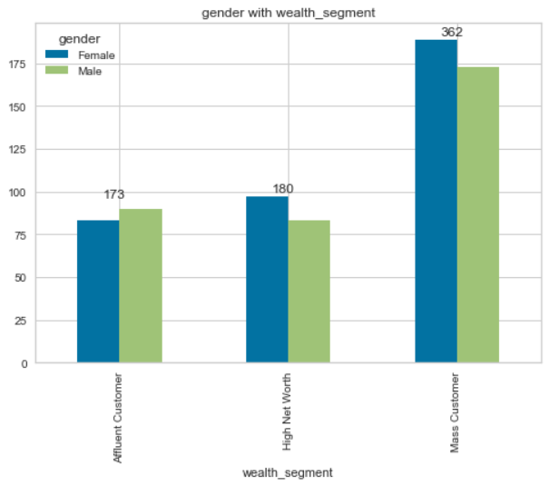
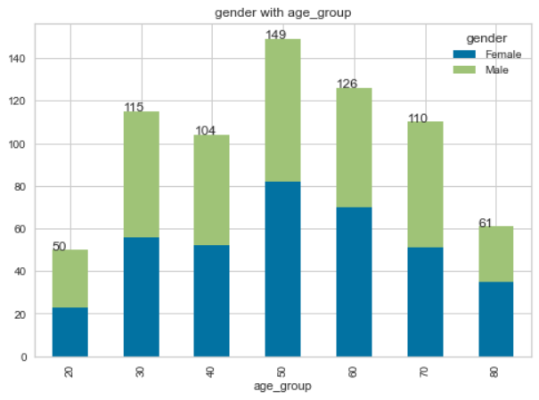
Note: The data and information in this document is reflective of a hypothetical situation and client. This document is to be used for KPMG Virtual Internship purposes only.
Data Exploration
Gender segment
Gender doesn’t seem to be much of impact in both wealth and age group
It’s appear we attract to both gender equally
There is a lack of non-binary gender in the data it’s possible that we are not attracted for them.

Slide 5
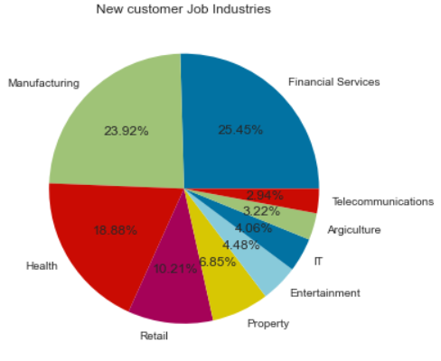
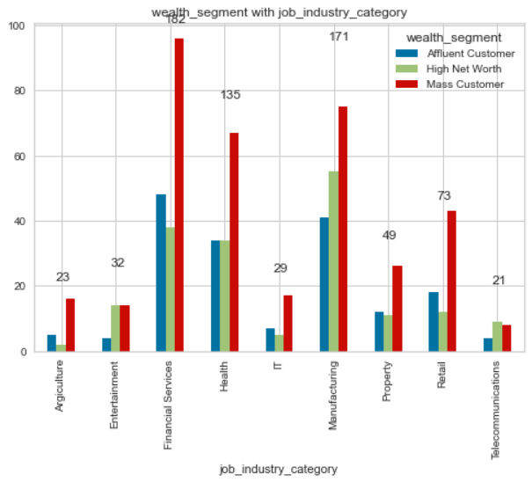
Note: The data and information in this document is reflective of a hypothetical situation and client. This document is to be used for KPMG Virtual Internship purposes only.
Data Exploration
Job industry
Our top customer is in Manufacturing and Financial Service.
This is great as both are a high profile customer.

Slide 6
Note: The data and information in this document is reflective of a hypothetical situation and client. This document is to be used for KPMG Virtual Internship purposes only.
Model Development
Targeting high value customer of the following:
Age group 40-50
Customer living in NSW
Customer working in Manufacturing and Financial Service.

Slide 7
Note: The data and information in this document is reflective of a hypothetical situation and client. This document is to be used for KPMG Virtual Internship purposes only.
Thank you

